Slide 1

Diamond price prediction
Eng. Ahmed Saeed

Slide 2


Data Extraction
1
Data Cleaning
2
Domain Knowledge
3
Data Analysis
4
Machine Learning
5
Model Deployments
6

Slide 3


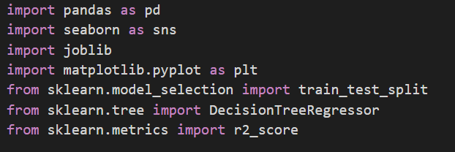
Data Extraction
1

Slide 4
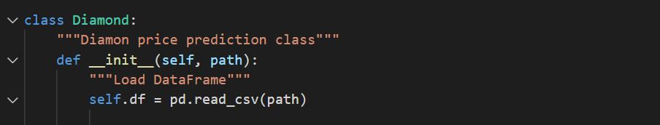
Data Extraction
1
Using API class python
Load dataset using pandas

Slide 5
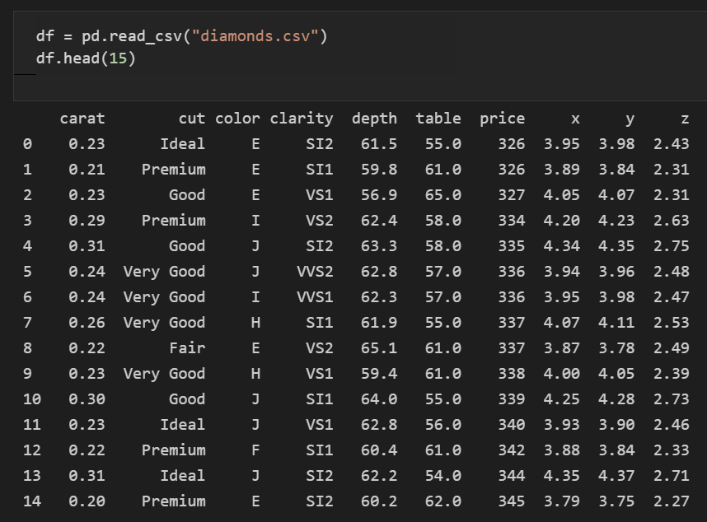
Data Extraction
1

Slide 6
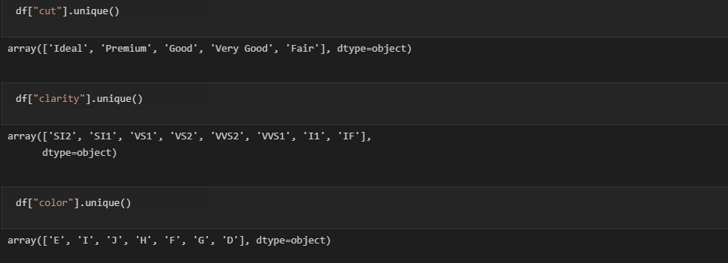
Data Extraction
1
How much unique categorical data?

Slide 7
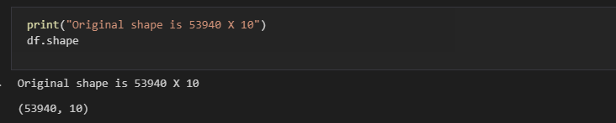
Data Extraction
1
Dataset size

Slide 8
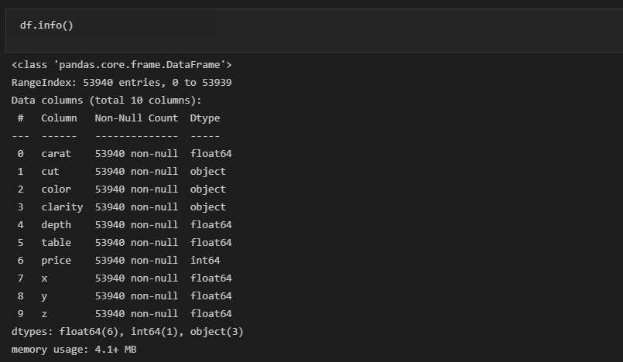
Data Cleaning
2
Dataset information

Slide 9
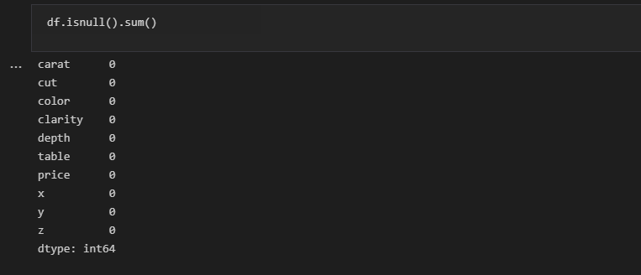
Data Cleaning
2
Is there null data?

Slide 10
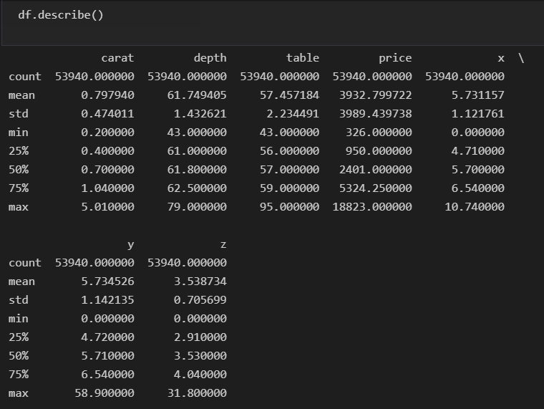
Data Cleaning
2
Is there null data?

Slide 11

Domain Knowledge
3
How to calculate the price of the diamonds?
Diamond the 4C`s.
Gemological Institute of America
1- Color
2- Clarity
3- Cut grade
4- Carat weight
These are the most important features.

Slide 12

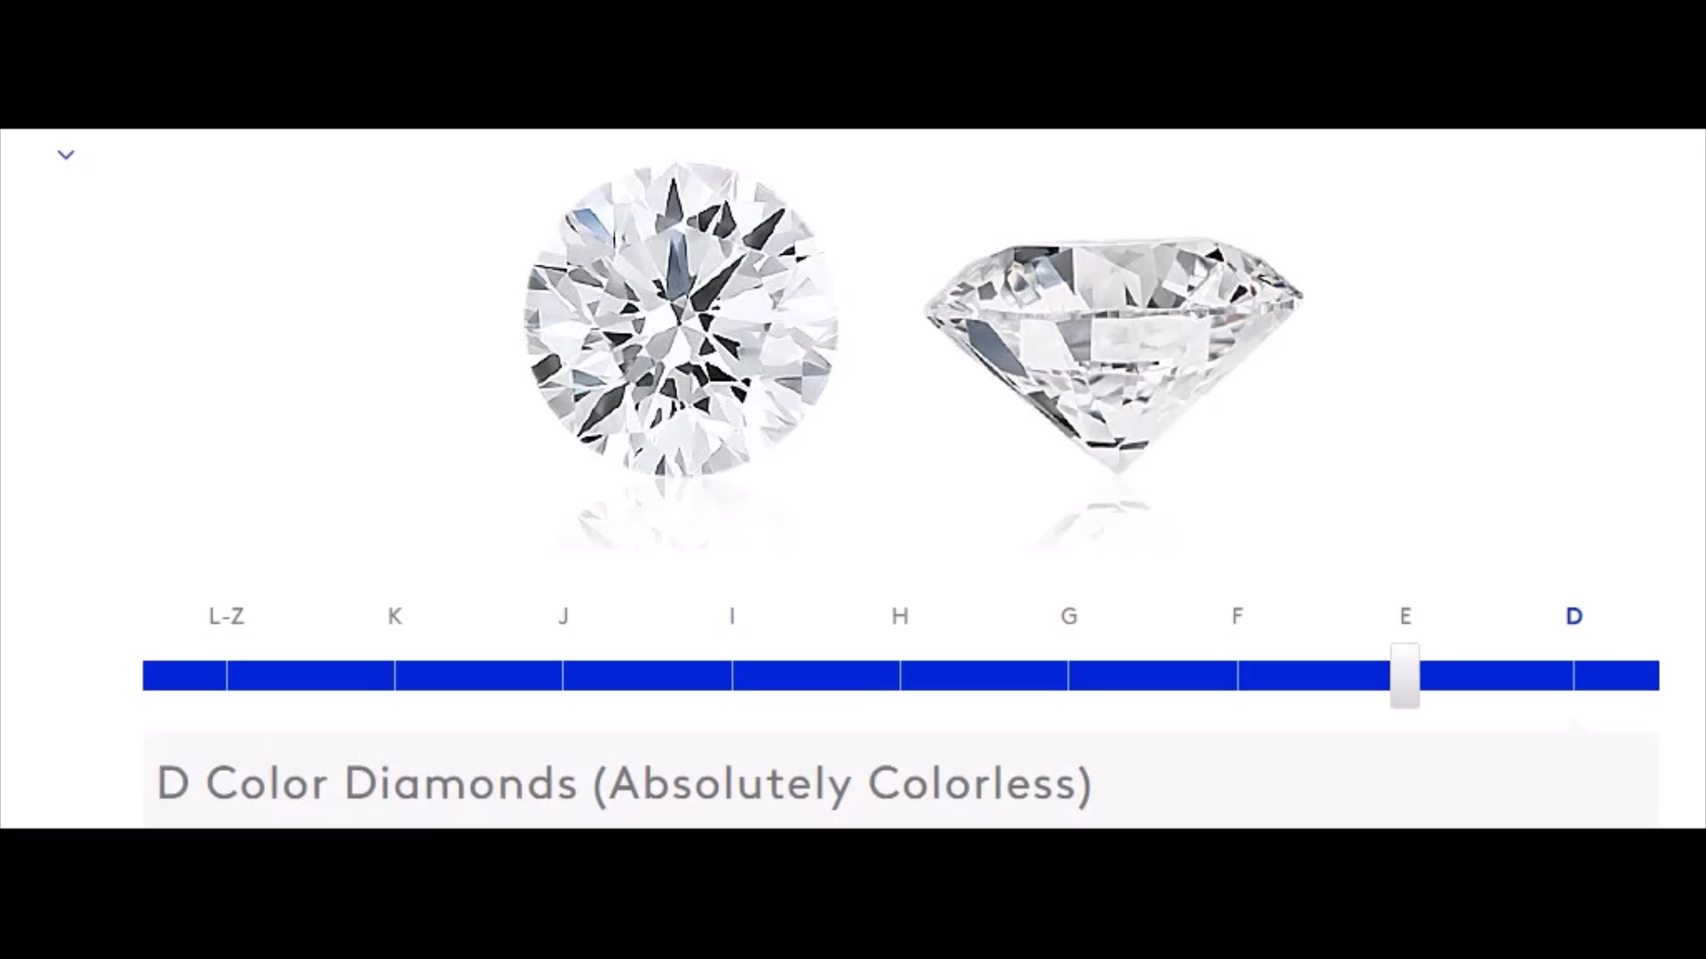
Domain Knowledge
3
1- Color
GIA’s D-to-Z diamond color-grading system measures the degree of colorlessness,
many of these diamond color distinctions are so subtle that they are invisible to
the untrained eye and make a very big difference in diamond quality and price.

Slide 13
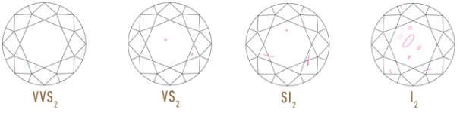
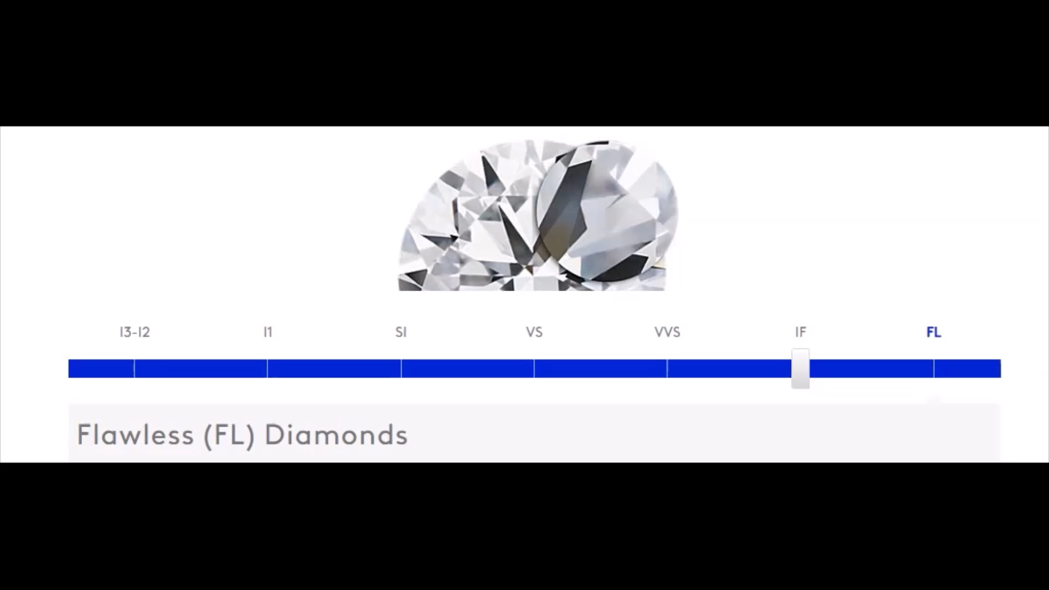

Domain Knowledge
3
2- Clarity
Diamond Clarity Refers to the Absence of internal Inclusions and external Blemishes.
Knowing what diamond clarity truly means helps you understand the factors that contribute to diamond quality and price.
“IF” is rarely found

Slide 14
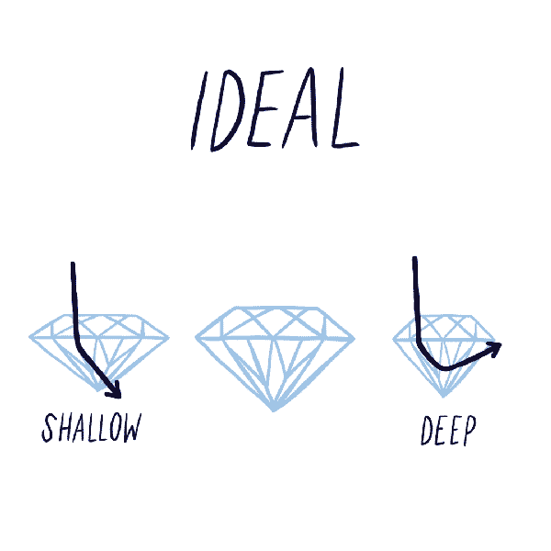
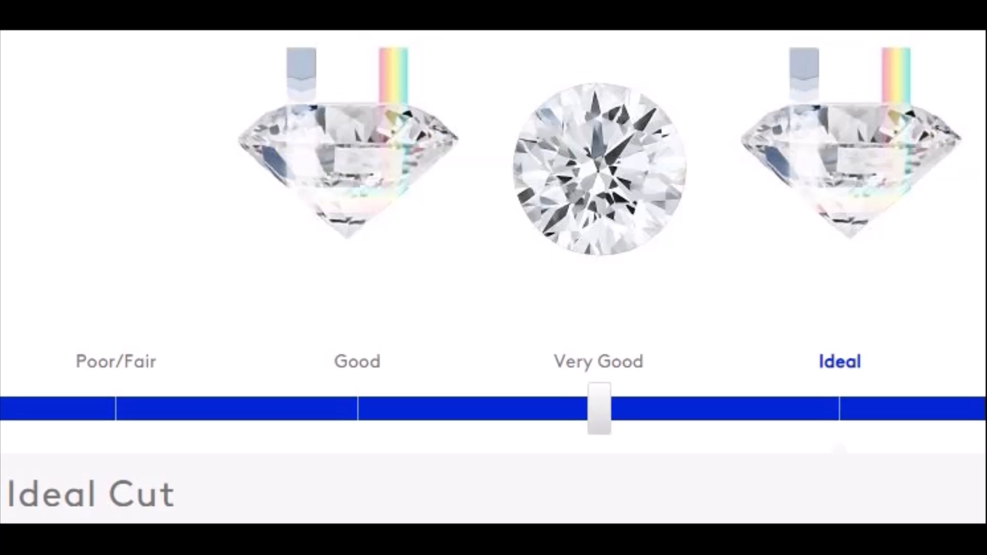
Domain Knowledge
3
3- Cut grade
Diamond Cut does not refer to a diamond’s shape, but what diamond cut actually does mean
how well a diamond’s facets interact with light and the quality of workmanship.
A well-cut diamond will direct more light through the crown.

Slide 15
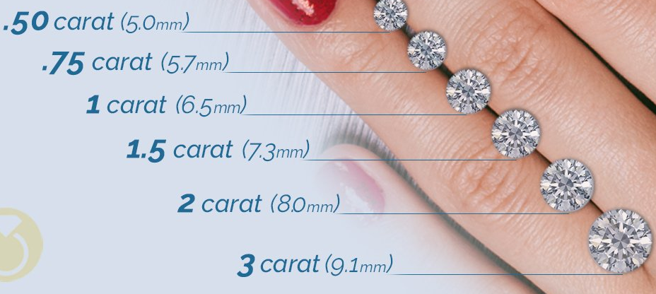
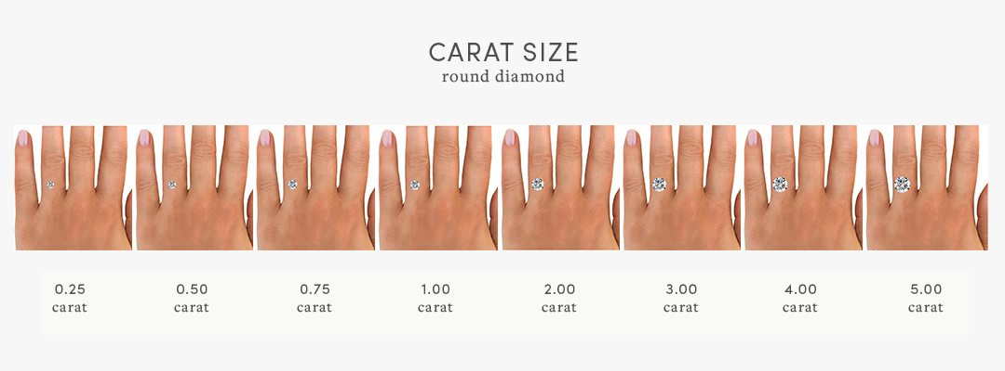
Domain Knowledge
3
4- Carat
Diamond carat weight measures how much a diamond weighs, and two diamonds of equal
carat weight can have very different values (and prices) depending on three
other factors of the diamond Color, Clarity, and Cut.

Slide 16

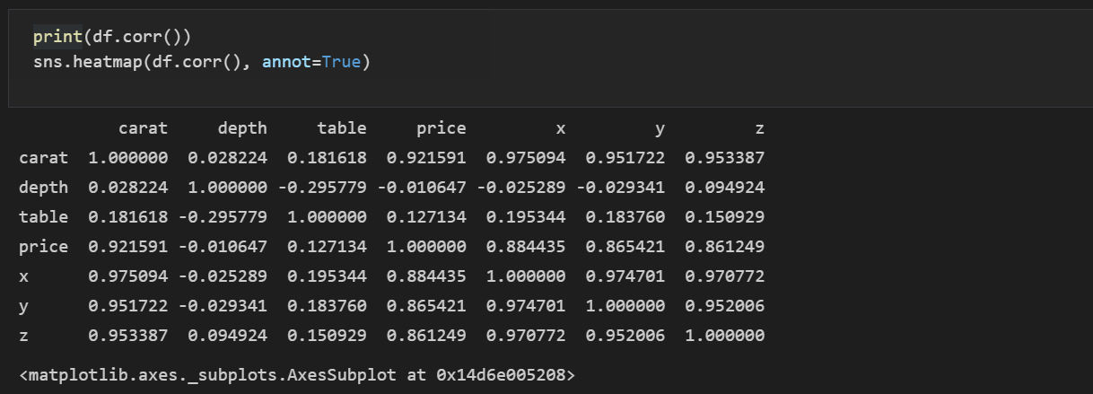
Data analysis
4
Correlations
Missing 3 important features because they are categorical

Slide 17
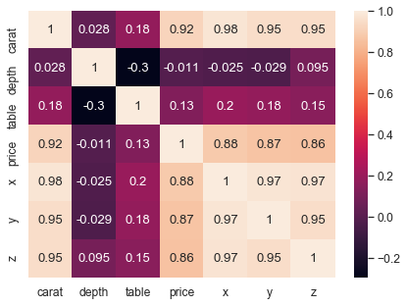
Data analysis
4
Correlations using heat-map

Slide 18
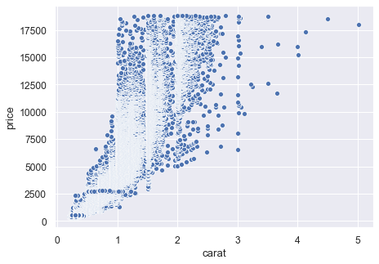
Data analysis
4
Visualize nominal data
Relation between carat and price.
Outliers?

Slide 19
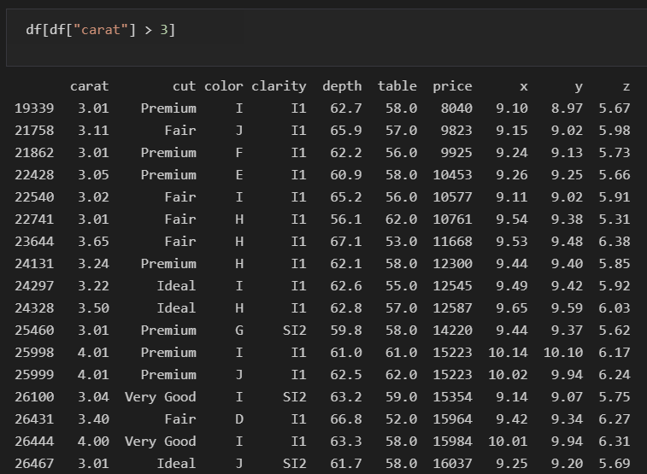
Data analysis
4
Decide to get rid of outlier(s).

Slide 20
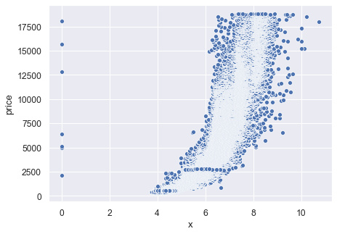
Data analysis
4
Visualize nominal data
Relation between X and price.
Outliers?

Slide 21
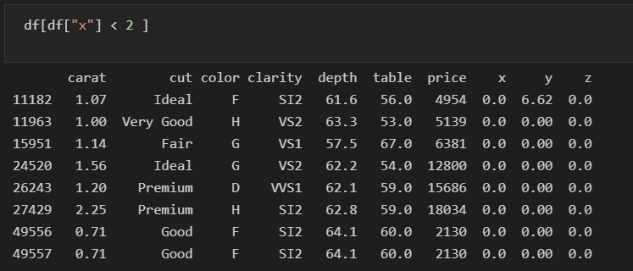
Data analysis
4
Decide to get rid of outlier(s).

Slide 22
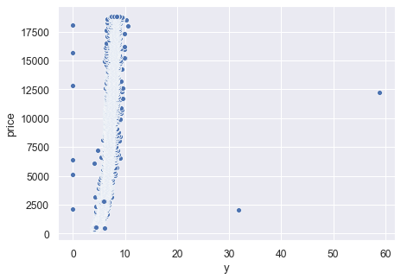
Data analysis
4
Visualize nominal data
Relation between Y and price.
Outliers?

Slide 23
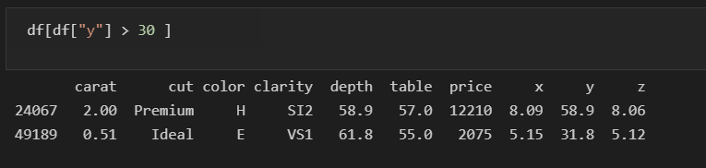
Data analysis
4
Decide to get rid of outlier(s).

Slide 24
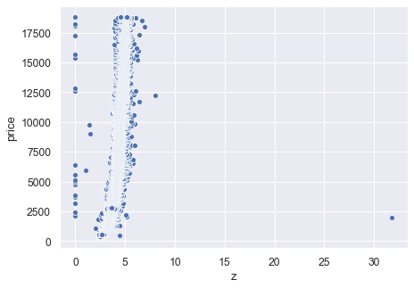
Data analysis
4
Visualize nominal data
Relation between Z and price.
Outliers?

Slide 25
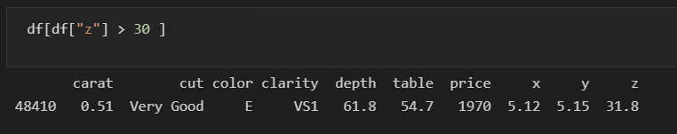
Data analysis
4
Decide to get rid of outlier(s).

Slide 26
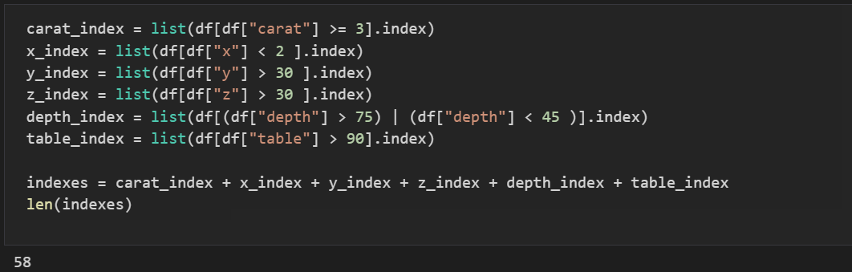
Data analysis
4
Get outliers indexes.

Slide 27
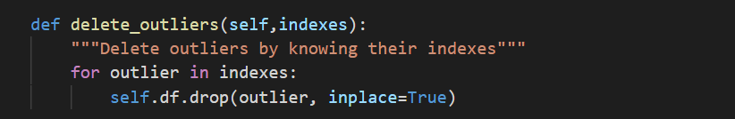
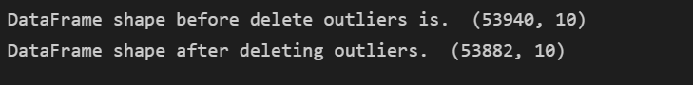
Data analysis
4
Delete outliers using their indexes

Slide 28
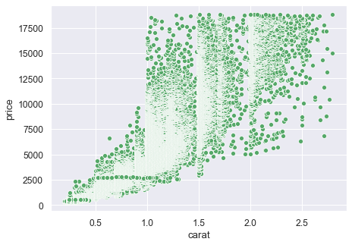
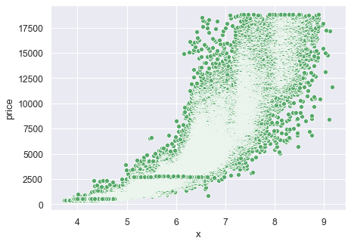
Data analysis
4
Visualize nominal data

Slide 29
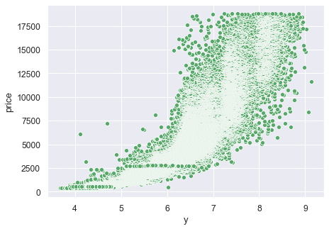
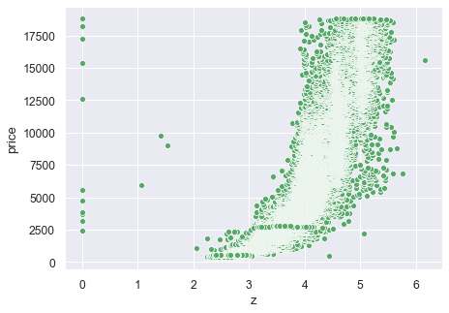
Data analysis
4
Visualize nominal data
Outliers?

Slide 30
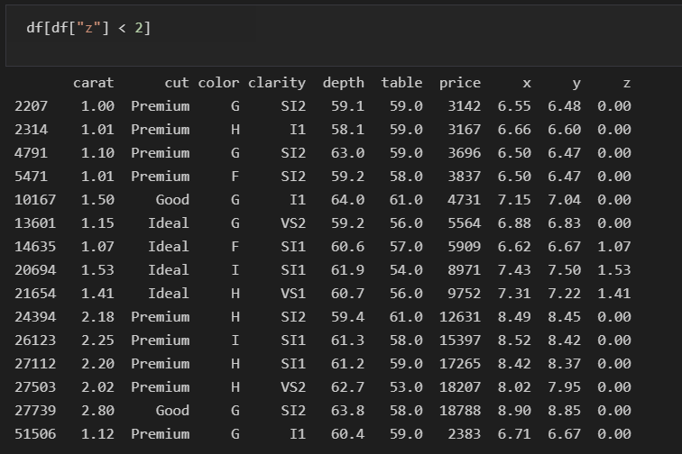
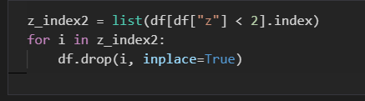
Data analysis
4
Decide to get rid of outlier(s).

Slide 31
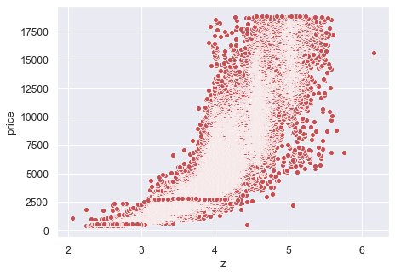
Data analysis
4
Visualize nominal data
Final scatterplot between z and price
After removing outliers

Slide 32
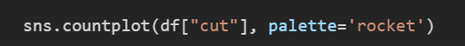
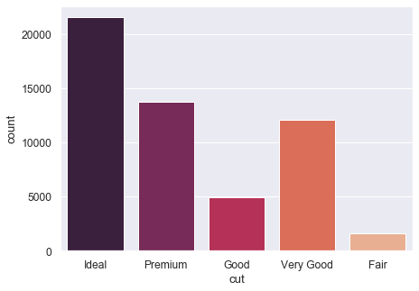
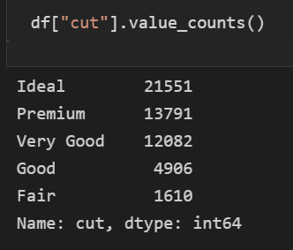
Data analysis
4
Visualize categorical data
Count-plot: Cut

Slide 33
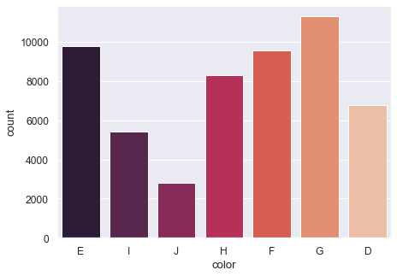
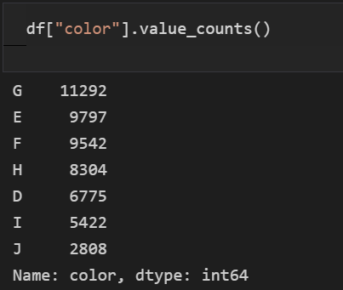
Data analysis
4
Visualize categorical data
Count-plot: Color

Slide 34
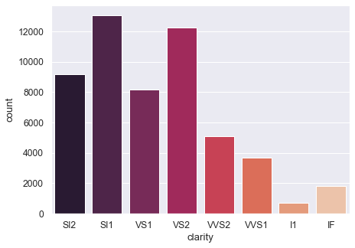
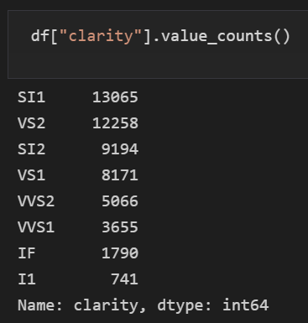
Data analysis
4
Visualize categorical data
Count-plot: Clarity

Slide 35
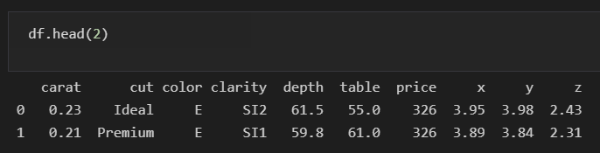
Data analysis
4
Convert categorical data.
Cut: Ideal > Premium > Very good > Good > Fair
Color: D > E > F > G > H > I > J
Clarity: IF > VVS1 > VVS2 > VS1 > VS2 > SI1 > SI2 > I1

Slide 36
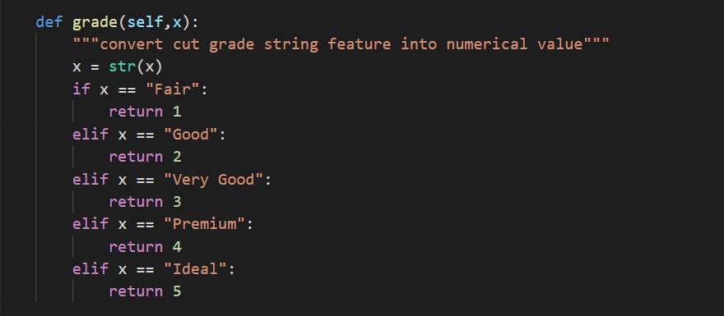
Data analysis
4
Cut: Ideal > Premium > Very good > Good > Fair

Slide 37
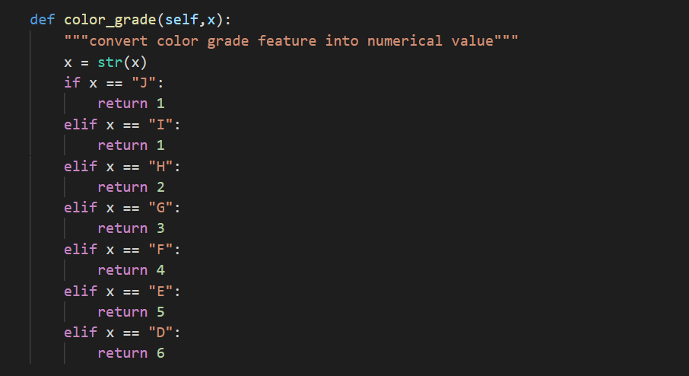
Data analysis
4
Color: D > E > F > G > H > I > J

Slide 38
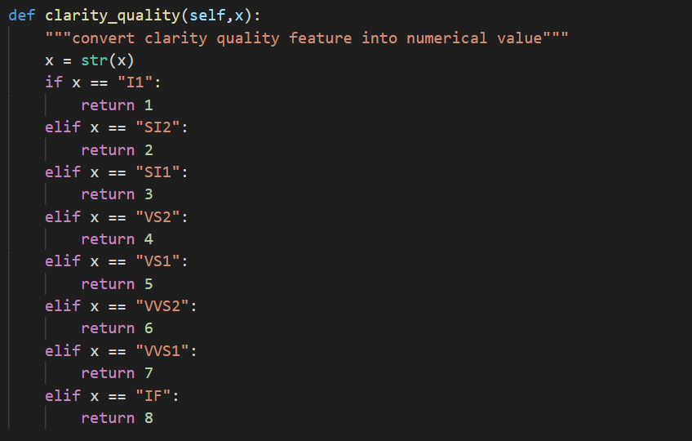
Data analysis
4
Clarity: IF > VVS1 > VVS2 > VS1 > VS2 > SI1 > SI2 > I1

Slide 39
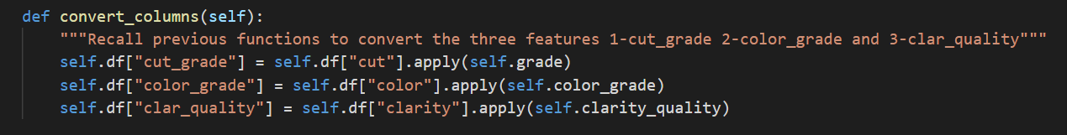
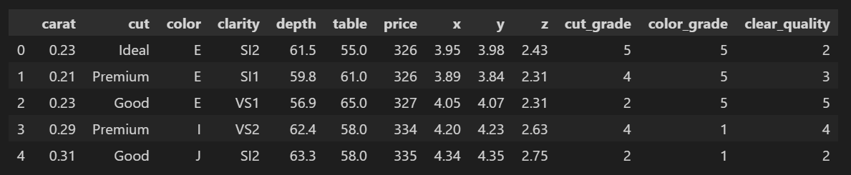
Data analysis
4
Convert columns.

Slide 40
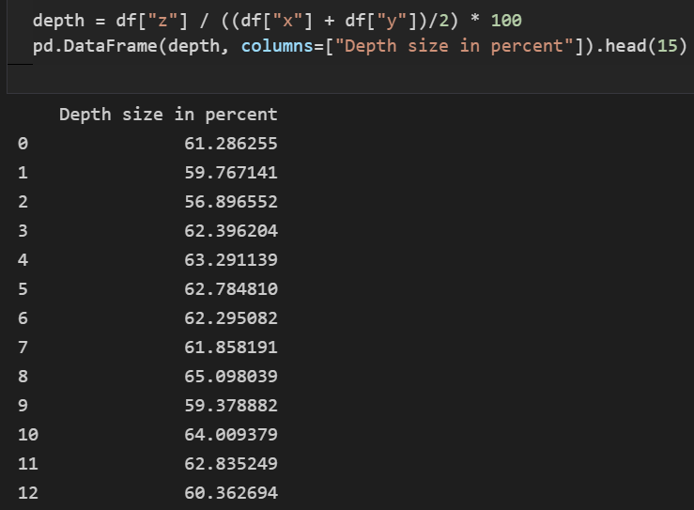
Data analysis
4
Knowing about depth feature.
Original dataset

Slide 41
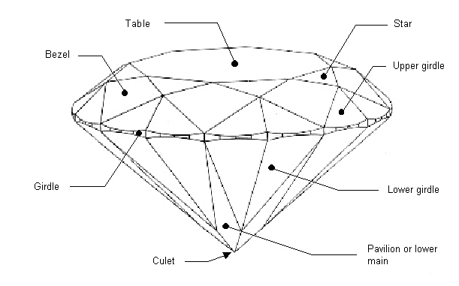
Data analysis
4
Knowing about table feature.
Delete this feature doesn't affect on the predictions.

Slide 42

Data analysis
4
Delete those unnecessary columns.
Final Dataset

Slide 43



Machine Learning
5

Slide 44


Machine Learning
5
X train
X test
y train
y test

Slide 45



Machine Learning
5

Slide 46

Machine Learning
5
Model performance on Training and Testing.

Slide 47



Machine Learning
5
R2 Score: with best possible score is 1.0
Using formula
R² = 1 - $\frac{RSS}{TSS}$
Where →
1 - $\frac{\text{((}\text{y}\text{_}\text{true}\text{ − }\text{y}\text{_}\text{pred}\text{) ∗∗ 2).}\text{sum}\text{() }}{\text{((}\text{y}\text{_}\text{true}\text{ − }\text{y}\text{_}\text{true}\text{.}\text{mean}\text{()) ∗∗ 2).}\text{sum}\text{() }}$

Slide 48




Machine Learning
5
Plot decision tree of 5 samples

Slide 49

Model Deployment
6
Save the model to used it in any application.

Slide 50


6
Time to lunch an application
Deploy model to
‘website’
Type in any browser: http://localhost:5000/

Slide 51






